Slide 1

Reinforcement Learning: Part 2
April 3rd, 2023

Slide 2
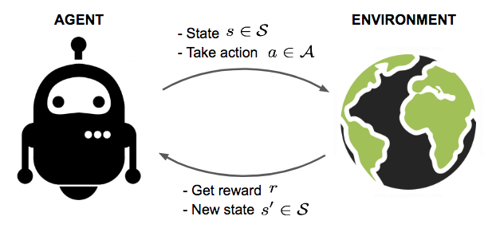
Review
Goal: Learn to take actions which maximize total reward.

Slide 3
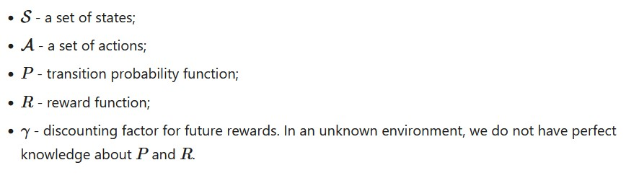
Markov Decision Process
Mathematical way to formalize most RL problems
Markov property: future depends only on current state

Slide 4
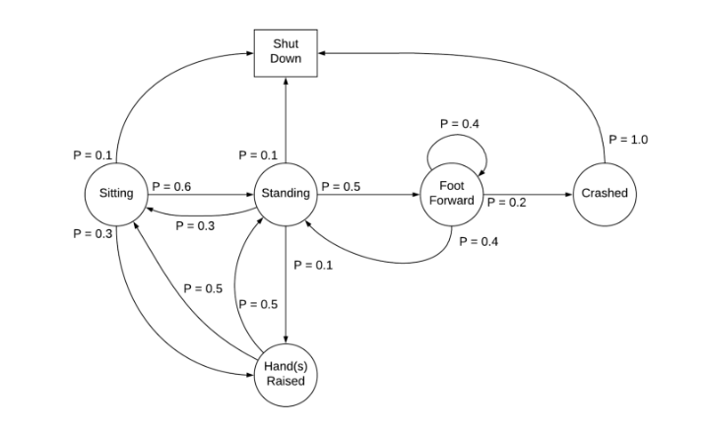
Markov Decision Process
Example MDP for a Robot

Slide 5
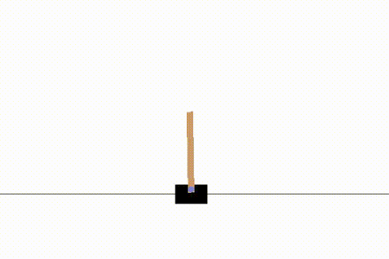
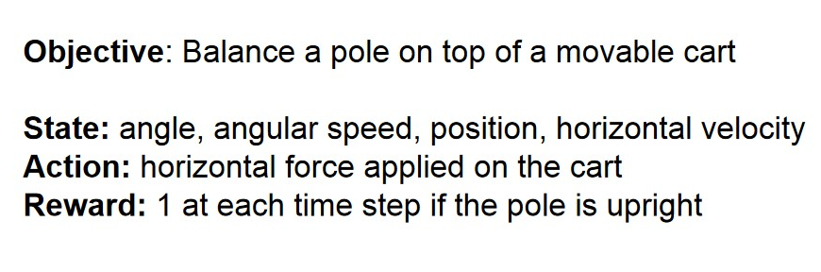
Example: Cartpole Problem
Old notebook: https://colab.research.google.com/drive/161IferJ3gE9bLZu-khTNL1bmN9Z6n2ez?usp=sharing

Slide 6
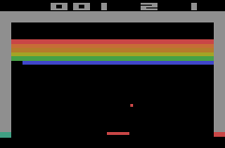
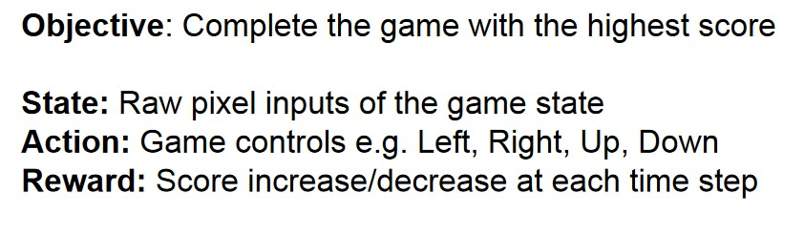
Example: Atari Breakout

Slide 7
Model
How the environment will respond to certain actions
Comes with reward function (R) and transition probabilities (P, chance of going from one state to another)
Either known or unknown
  Known → model-based RL, use dynamic programming
  Unknown → model-free RL / try to learn the model
Generally speaking, we try to learn the policy and value functions

Slide 8
Policy
π(s): guideline which aims to maximize expected sum of rewards
On-policy: evaluate/improve the same policy being used to select actions
Off-policy: improve a policy independent of action selection

Slide 9


Value
Value function V(s): how good a particular state is, based on expected cumulative reward
Use a discounting factor γ to penalize future rewards
  Uncertainty, no immediate benefits
Q-value function Q(s, a): based on state action pairs, “quality”
Notes:
Optimal policy function maximizes value function
Optimal value function maximizes expected return

Slide 10
Approaches

Slide 11
Dynamic Programming
Model-based RL
Update based on Bellman equations: decompose value function into immediate reward + discounted future rewards
Iteratively evaluate/improve policy

Slide 12

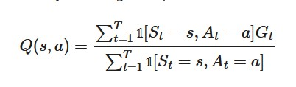
Monte Carlo (MC) Methods
Model-free!
Idea: Learn from episodes of experience only
Average returns over multiple episodes to approximate expected return for a particular state / state-action pair

Slide 13
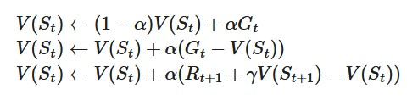
Temporal Difference (TD) Learning
Model-free, can learn from incomplete episodes (!)
Bootstrapping: use estimates to update instead of actual rewards/empirical returns from Monte Carlo

Slide 14
SARSA
On-policy TD control
Choose action based on current state
Pick A[t+1] in the same way
Update:
Repeat

Slide 15
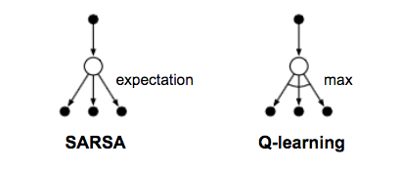
Q-Learning
Off-policy TD control
Does not follow current policy to choose next action
Use best Q value, not Q value generated by a particular action
Notes:
https://stats.stackexchange.com/questions/326788/when-to-choose-sarsa-vs-q-learning
Q learning has issues with convergence due to higher per-sample variance
SARSA is more conservative, will avoid a dangerous optimal path

Slide 16
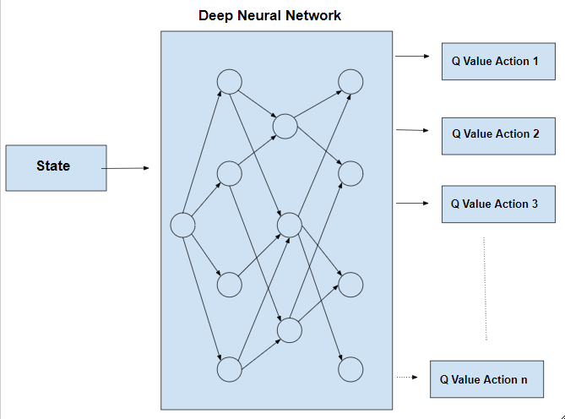
Deep Q-Network
Proposed by DeepMind in 2015
Problem: learning every (s, a) pair is space-inefficient
Solution: Use a neural network as a function approximator for Q values

Slide 17
Deep Q-Network
Experience Replay: Instead of generating new experiences each time, learn from previous experiences
  Store agents experiences in each timestep
  Randomly sample during Q-learning updates
  Improves data efficiency
Periodically Updated Target: Only update target values periodically (freeze network every C steps)
  Makes training more stable

Slide 18

Deep Q-Network

Slide 19
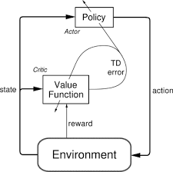
Policy Gradient
Learn the policy directly as opposed to Q/V
Examples:
  REINFORCE (Monte Carlo)
  Actor-Critic
  A3C
Read this link
Actor-Critic Architecture
Notes:
https://medium.com/intro-to-artificial-intelligence/the-actor-critic-reinforcement-learning-algorithm-c8095a655c14
Actor influences action, critic evaluates

Slide 20
Exploration-Exploitation
Without enough exploration, we can’t learn the environment well enough
  → Cannot fully optimize towards reward
Common solution: ε-greedy algorithm
  When picking any action, there is a chance that a random action is taken

Slide 21
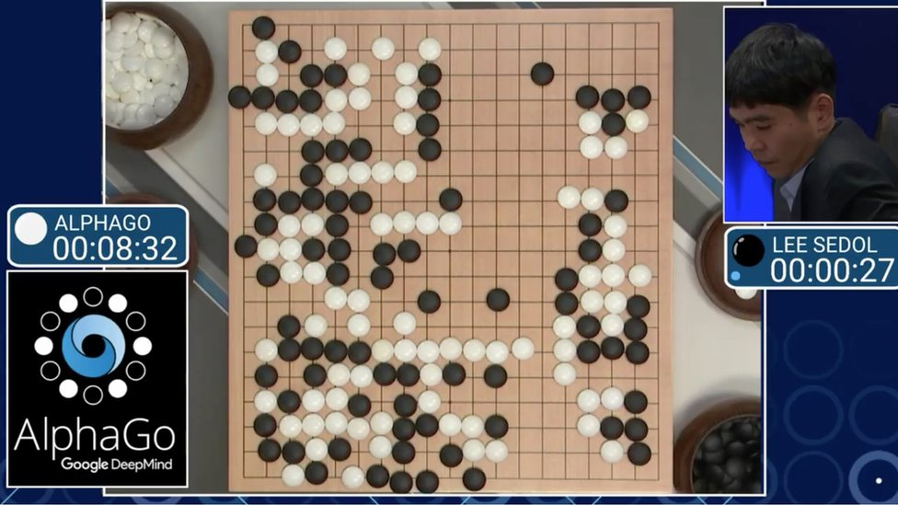
Example: AlphaGo
Initialize policy network via supervised learning from professional Go games, train w/ policy gradient
Learn value network too (actor-critic)
Combine policy and value networks via MCTS, lookahead search

Slide 22

Example: VizDoom
Also check out OpenAI Gym

Slide 23
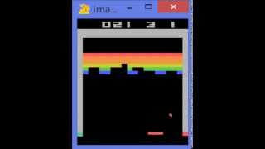
Example: Atari Breakout (DQN)

Slide 24
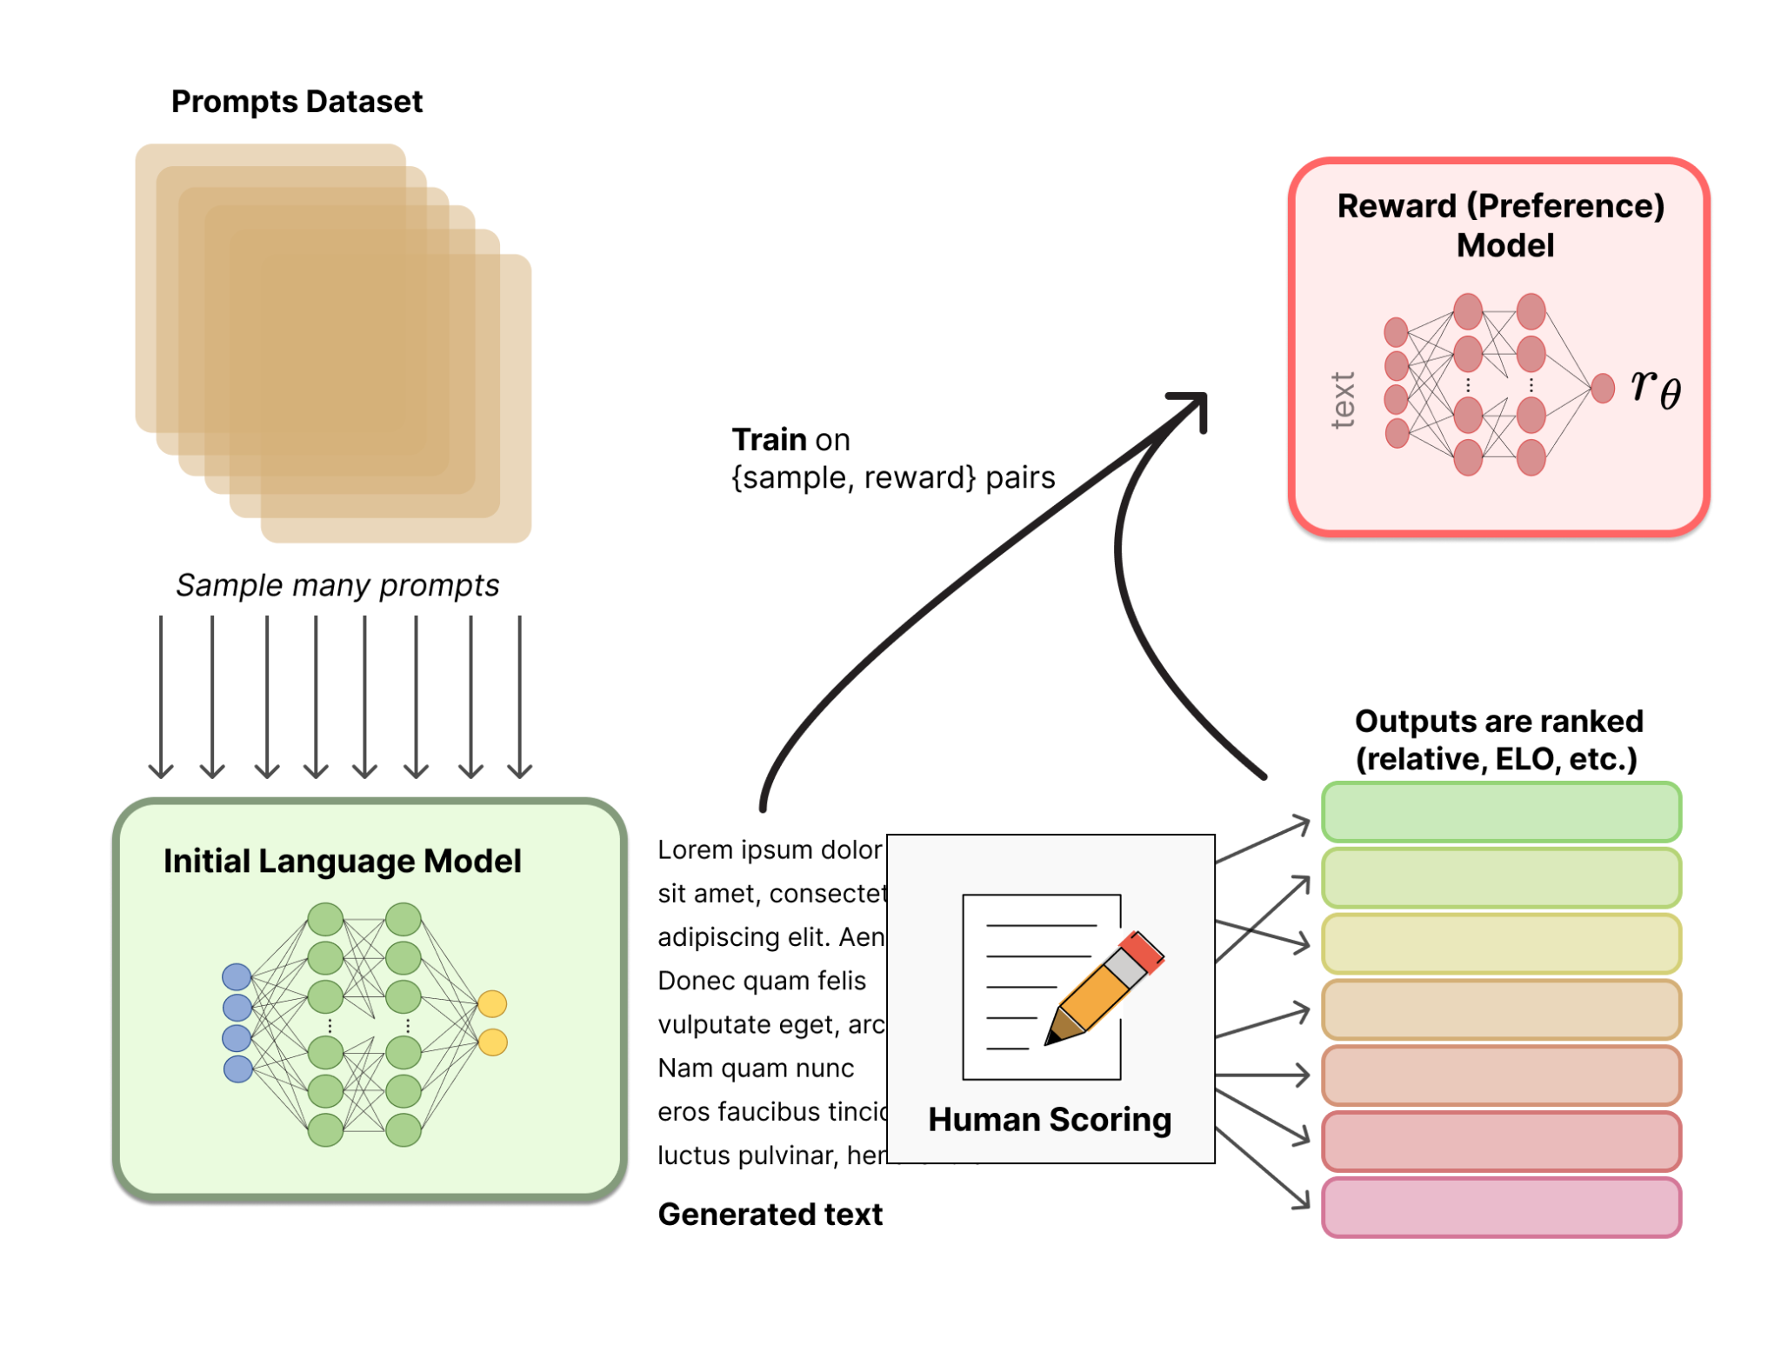
Applications
AlphaZero: CNN + RL
RLHF: Reinforcement Learning from Human Feedback
Self-driving
Robotics
Much more…
Notes:
Relationship Extractions
Physical Systems Modeling
Combinatorial Optimization
Graph Generation

Slide 25
Additional Resources
Stanford CS234: Reinforcement Learning (link)
Lilian Weng’s blogposts
  A (Long) Peek into Reinforcement Learning: link
  Policy Gradient Algorithms: link
HuggingFace on RLHF: link

